Slide 1
23-24 Final Demo
COSC 402-01

Slide 2
Quality Assurance

Slide 3
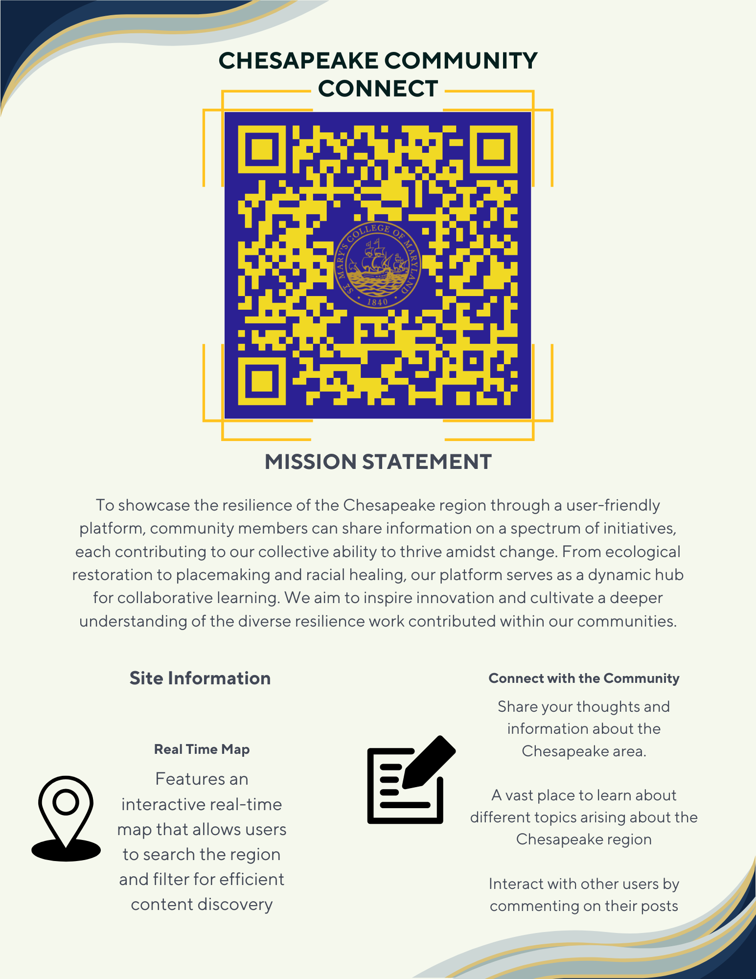
Flier
Creation of the Qr Code
Static QR code generated through a third party website.
Placeholder until the url and website is completed.
Visual Hierarchy
The need of a visual hierarchy was important.
Many flier-creating websites required payment to use certain functions that would make the flyer visually appealing; however, Canva has enough free tools that we were able to create a visually appealing flier without spending any money.

Slide 4
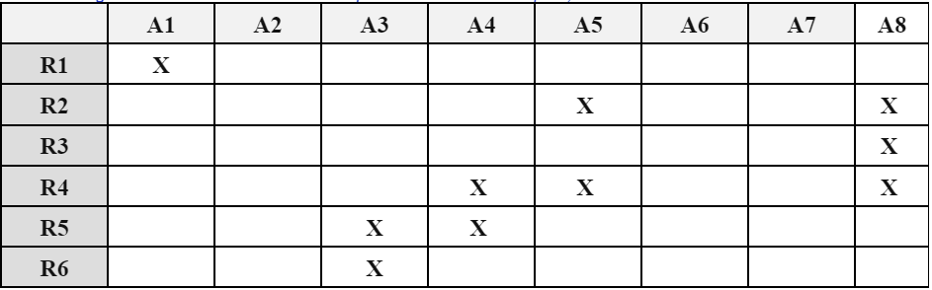
Traceability Matrix
We created a Traceability Matrix that allows for a easy look to see what aspects of the website are necessary to create before certain functionalities are able to be employed. Below is a part of it where A1-A8 represent aspects of the website and R1-R6 are requirements outlined in the SRS.
Notes:
R1: Homepage, R2: Contributor page display, R3: Help/Tutorial Page, R4: About Page Display, R5: Admin Page, R6: Contact Us Page Gavin
A1: Homepage Functionality, A2: Map Functionality, A3: Site Features, A4: Admin Functions, A5: Account Creation/Deletion, A6: Filtering Capabilities, A7: UI/UX, A8: Page Display

Slide 5
User Manual
We begun working on the User manual which once completed next semester will be deployed with the website.
The User manual will be useful for both admins to outline their respective roles and functionalities that are available to them.
The user manual will also be vital for people who will be maintaining the website in outlining how the processes needed to keep the site running.
Notes:
Gavin

Slide 6
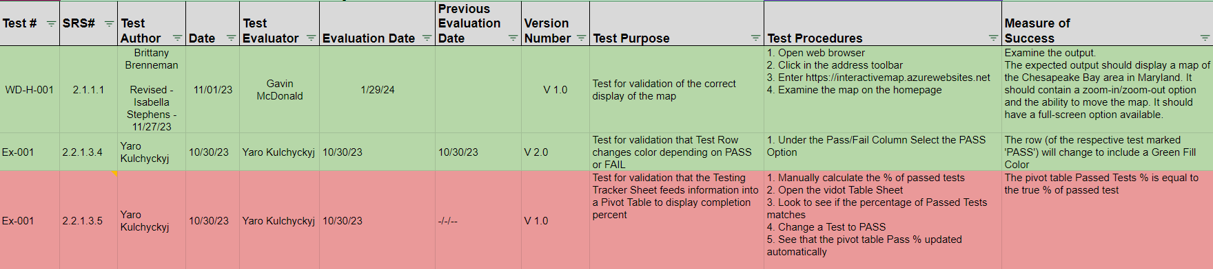
Testing
As work on the website progressed throughout the semester we completed tests of the website’s functionalities in accordance to the testing procedures outlined in the STP
Screenshot of the STP including a few testing procedures which are highlighted green if passed

Slide 7
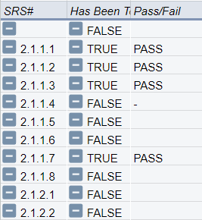
Adaptations to Previous Documents
SRS Document:
Added an editing option for all accounts within the admin page.
Included a functionality to open up a specific upload by clicking the “View more” at the bottom of the descriptive box which will open a new page that will list that upload within the others within the same area or same pin.
Adding a functionality to the requirement “2.1.5.8 Add a filter” section.
STP Document:
Standardized STP codes.
All tests written in relation to the STP code.
Created a new table to show more easily show the amount of tests completed.

Slide 8
Research & Development

Slide 9
Website Styling Changes
Map Page
Cleaned up the design
Most of the page is taken up by the map, while the search form takes up the right side of the screen
About Us
Completely overhauled the design of the page
Contact Us
Moved the contact us form under the Help/FAQ page
Overall
Standardized the styling over the entire website to ensure each button looks similar, all text is in the same font, and all colors are standardized.

Slide 10
Post and Map Functionality
Map Widgets
Map widgets display the location of posts on the map.
Clicking on a widget will take the user to that post’s page.
User Post page has slideshow of all content, including the maps instance with the post location
Search Posts
On the map page, users can search for posts by name and by tags.
The results are displayed as widgets on the map.
Create a Post
Under the Contributors tab, users can create a post.
If the user is a trusted user, the post will be immediately posted, else, the post will go into a pending phase.

Slide 11
Admin/Moderation Capabilities
An admin tab was added that allows approved users to perform a number of moderation tasks
Approving/denying posts made by normal users
Viewing contact requests made through the help page
Viewing reports made against users and posts
Manage a post's visibility
Add/remove tags to the tagging system
Edit a user's displayed account information and change their permission level (admin only)

Slide 12
Site Deployment/SysOps
Deployment
Deprecated all old package management code used for Microsoft Azure in favor of using Google Cloud
Google Cloud App Engine
Set up Google Cloud App Engine to host our website live using the Google Cloud Shell
Automatic Github Deployment was lost in this process, automating cloud deployment is more difficult than our previous method with Azure
API Key Management
Migrated API keys and Google Cloud utilities from personal accounts to the SMCM Project Manager account

Slide 13
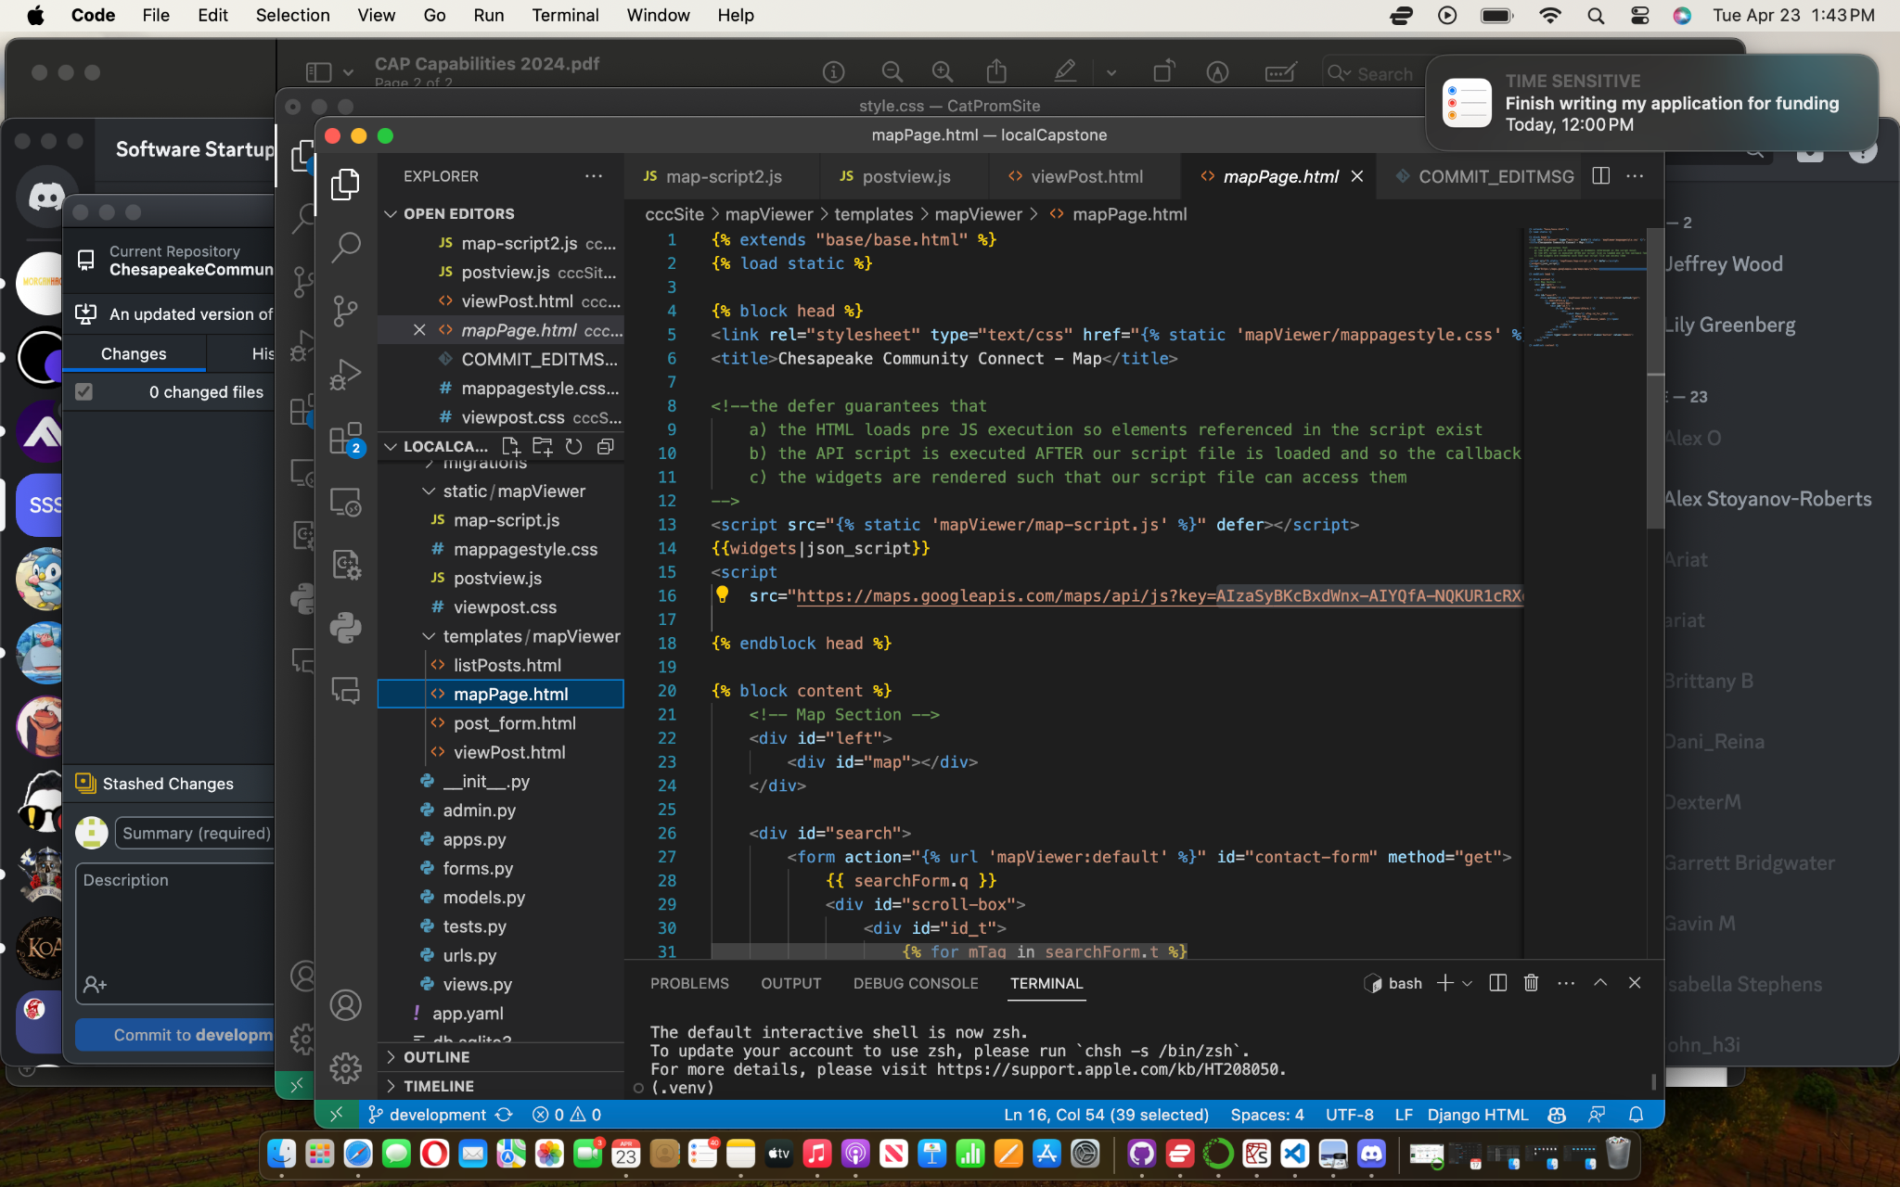
Security Concerns
API MANAGEMENT
Move API keys to .ENV file to be passed as environment variable and not hardcode.
PASSWORD HASHING
Make a salt and hashed password system for user accounts, and store in a hashed folder.

